Slide 1

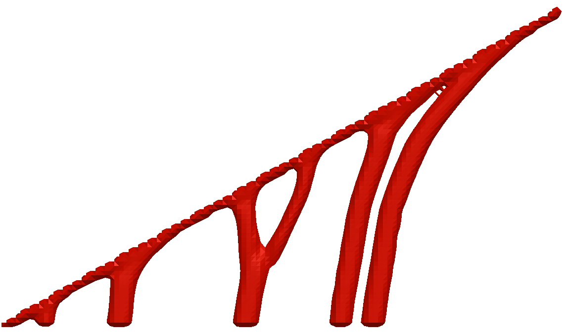
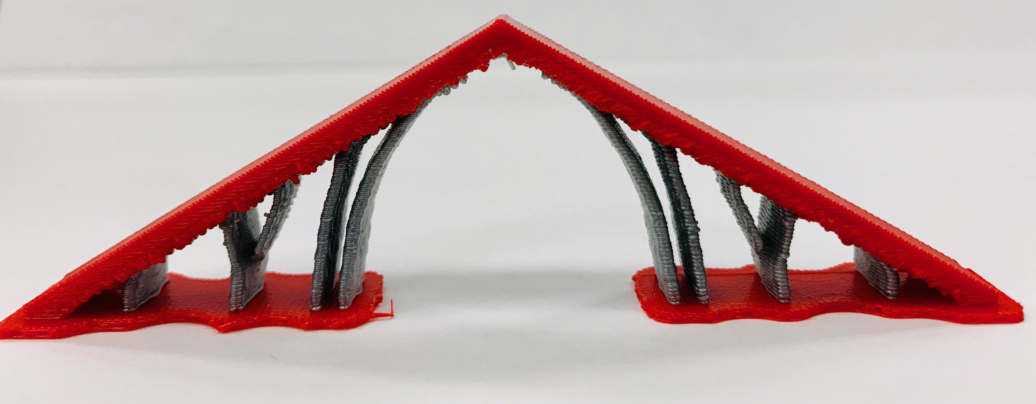


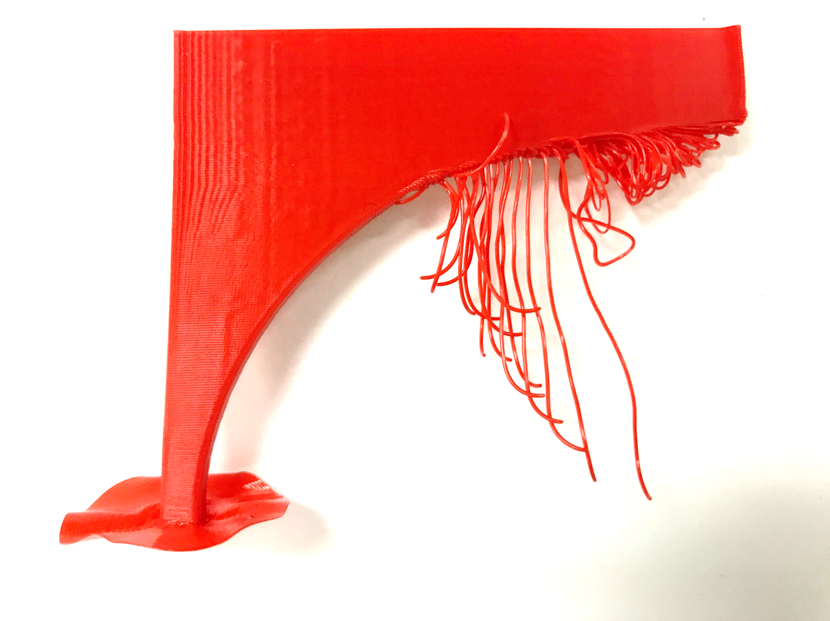
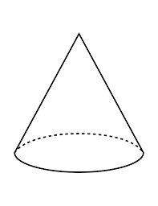
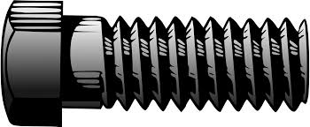
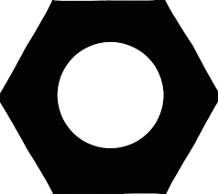
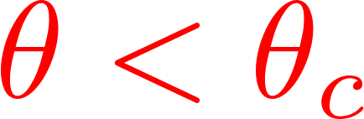
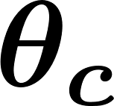

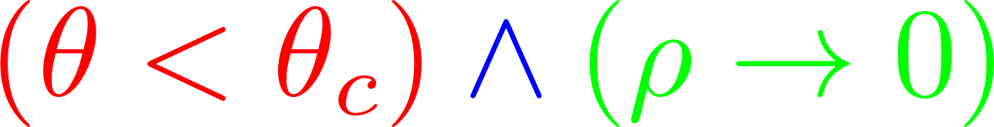

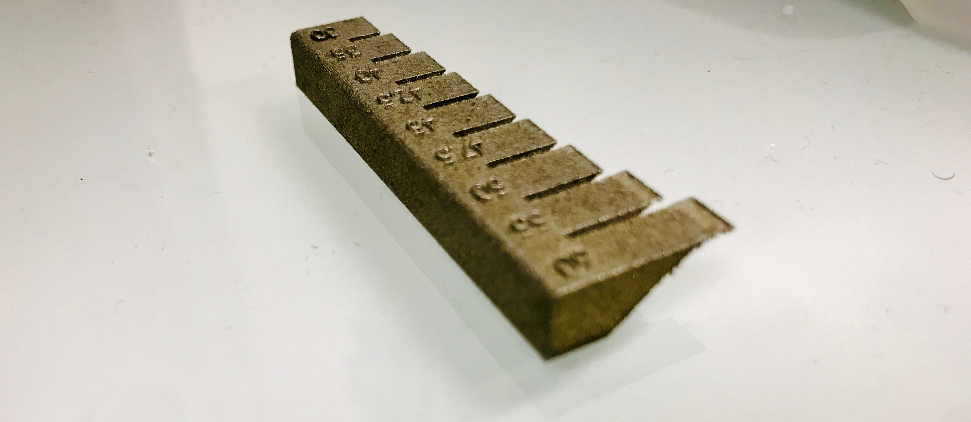
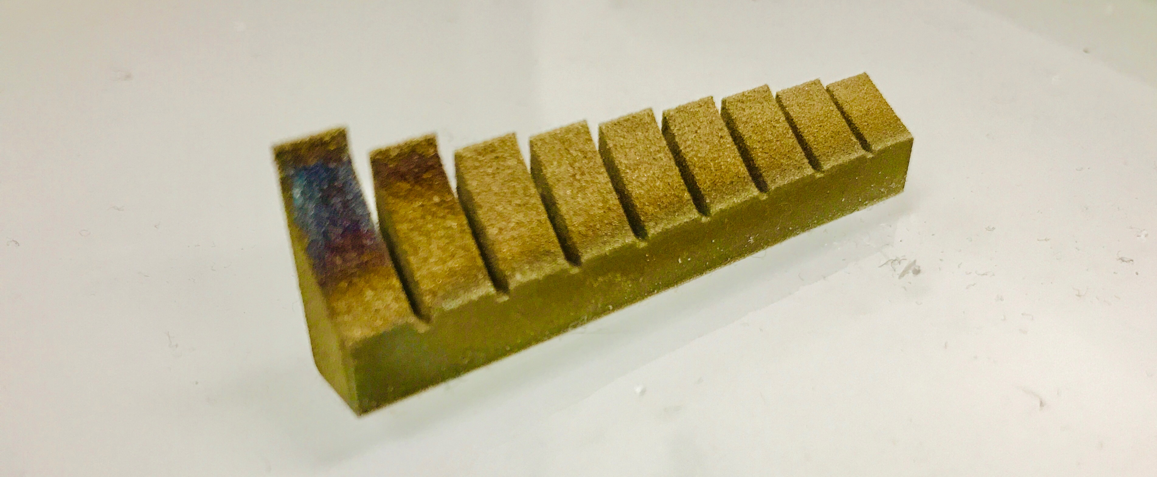
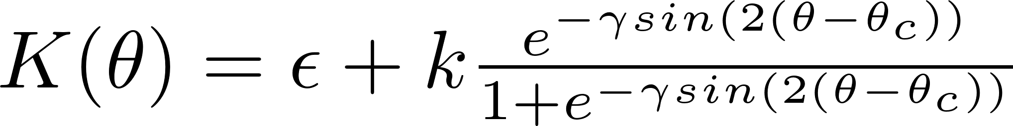


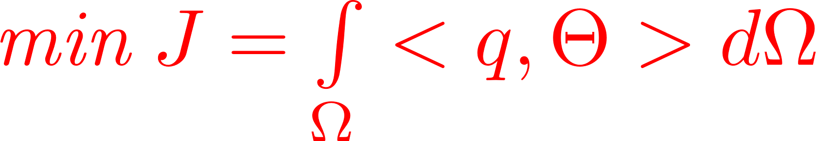
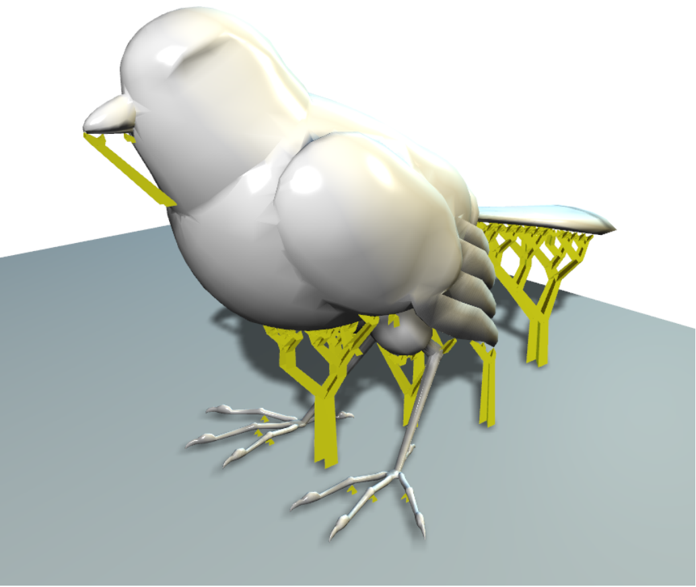
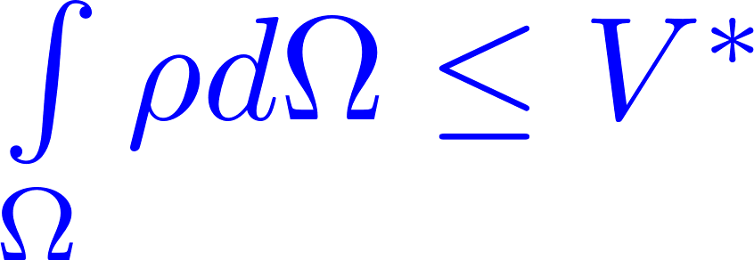
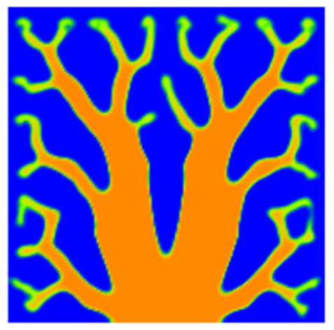
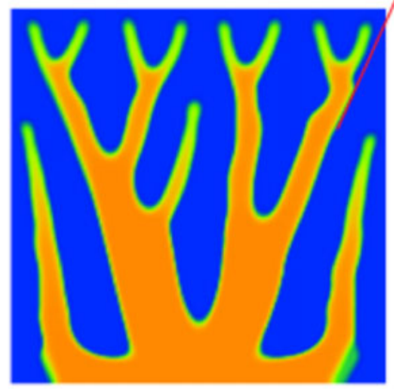

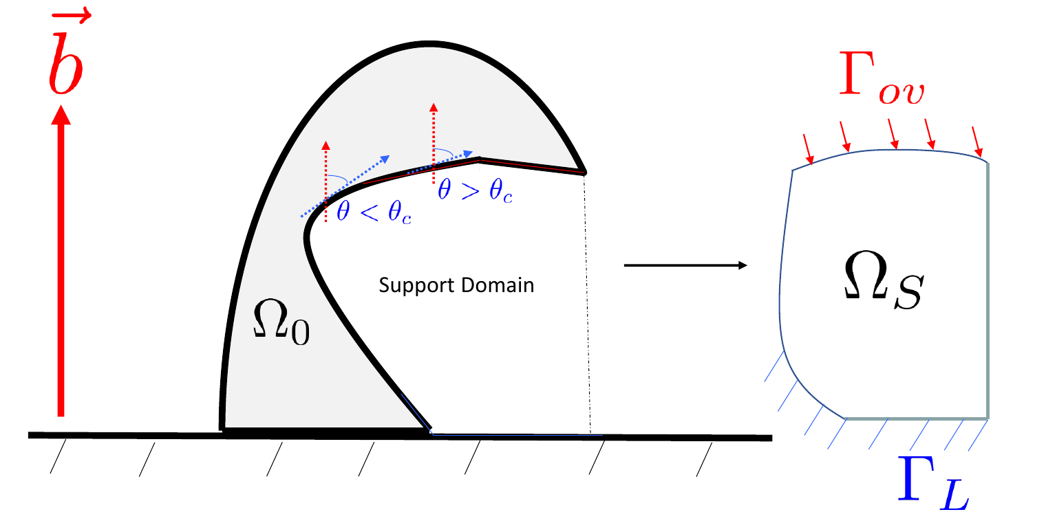
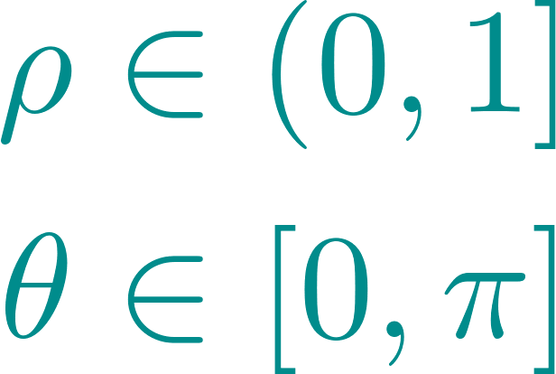
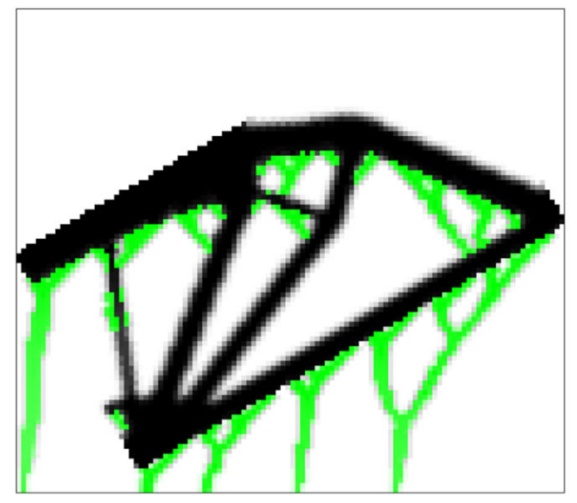
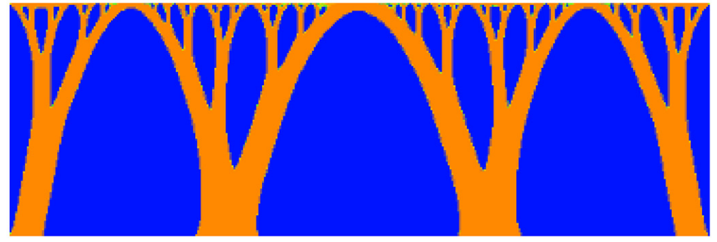
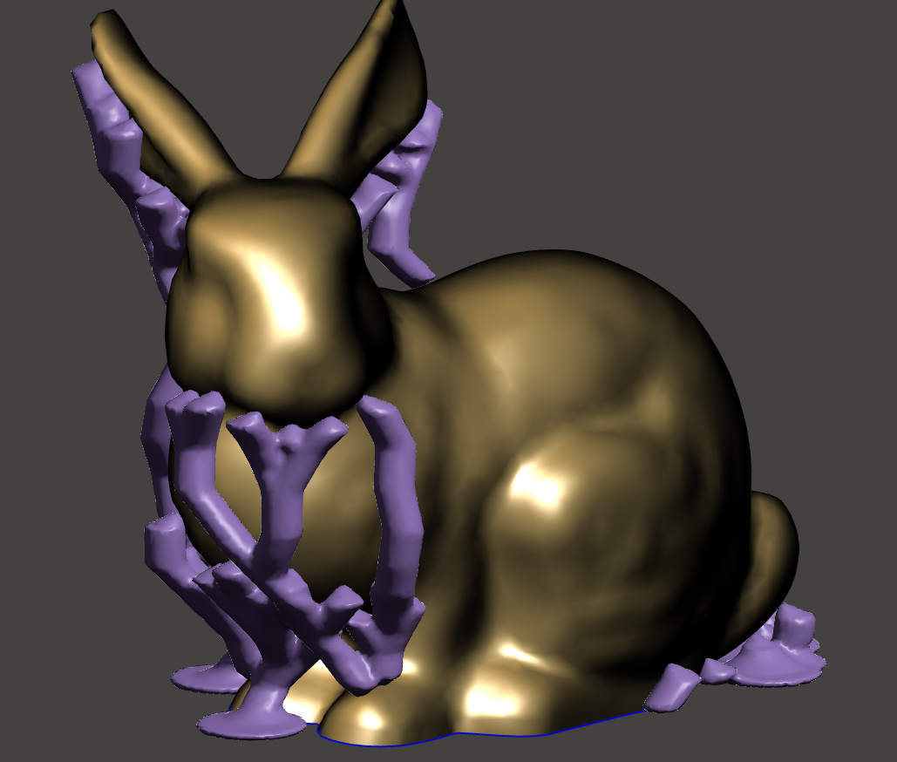


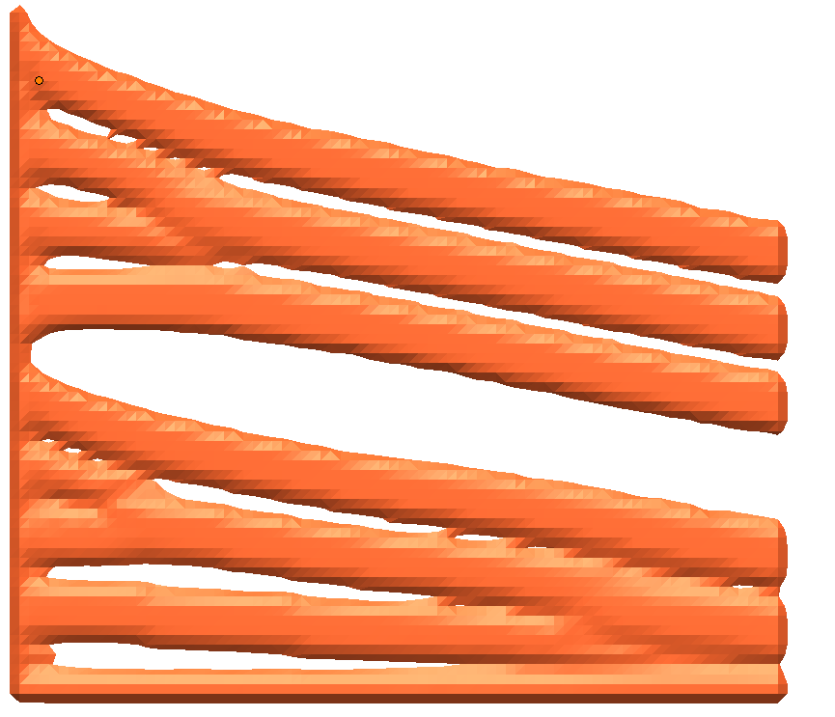
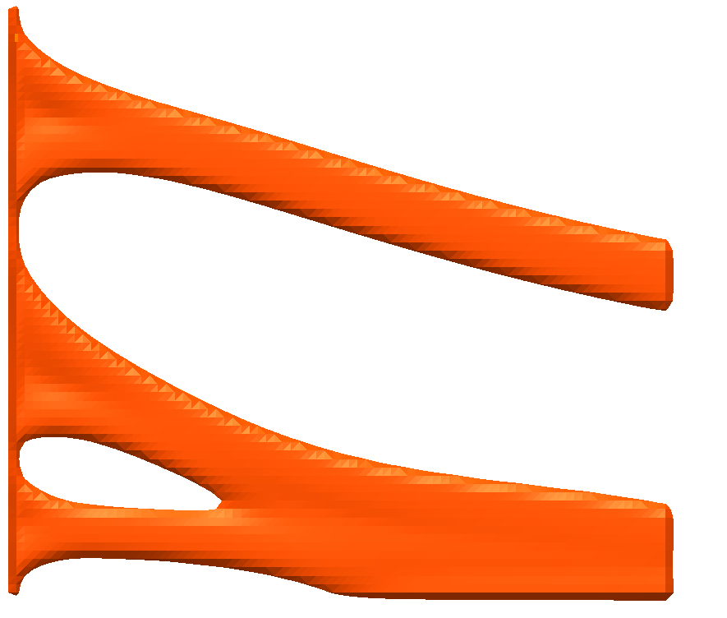
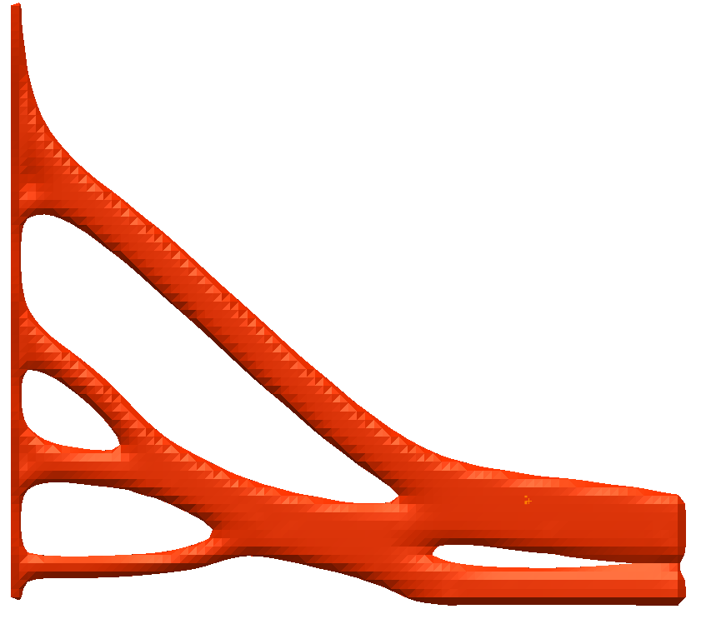

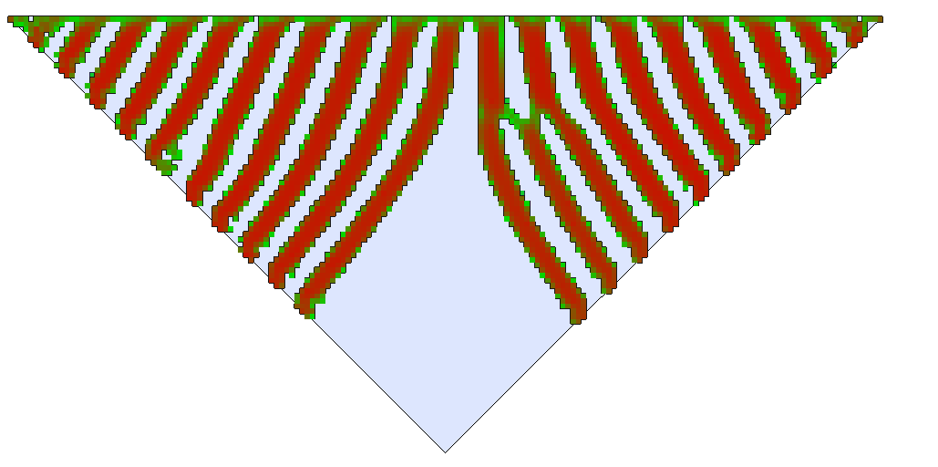
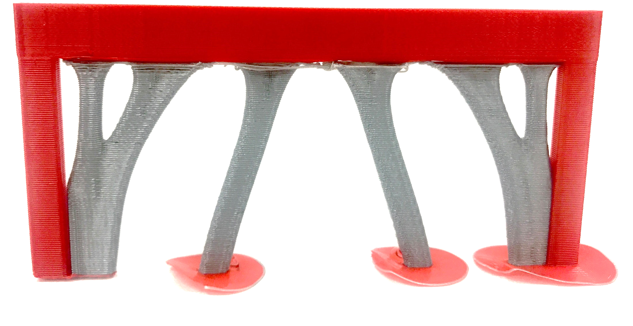

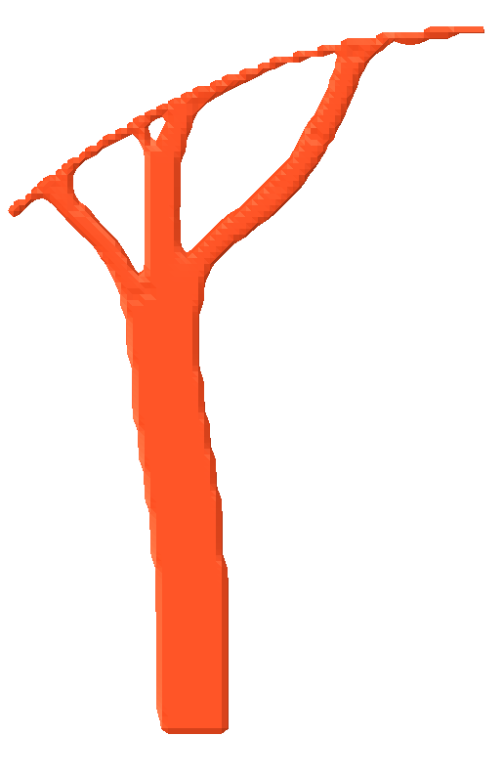
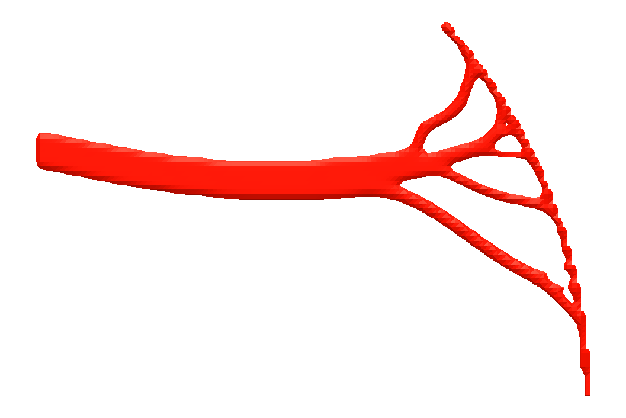
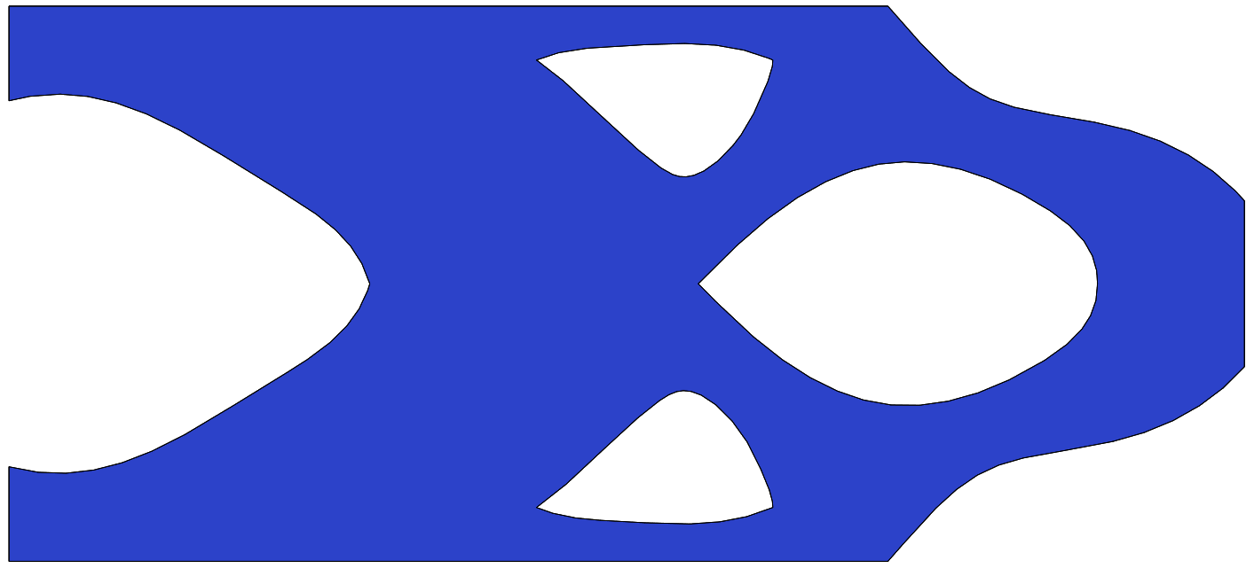
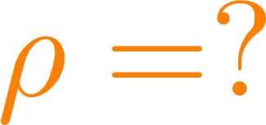

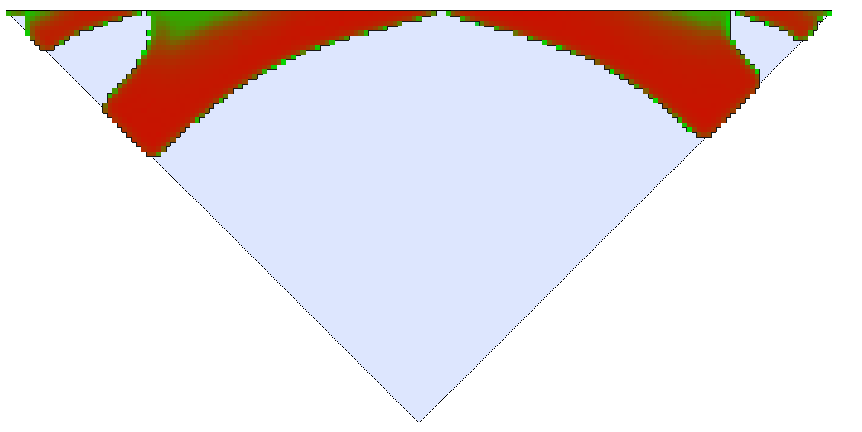
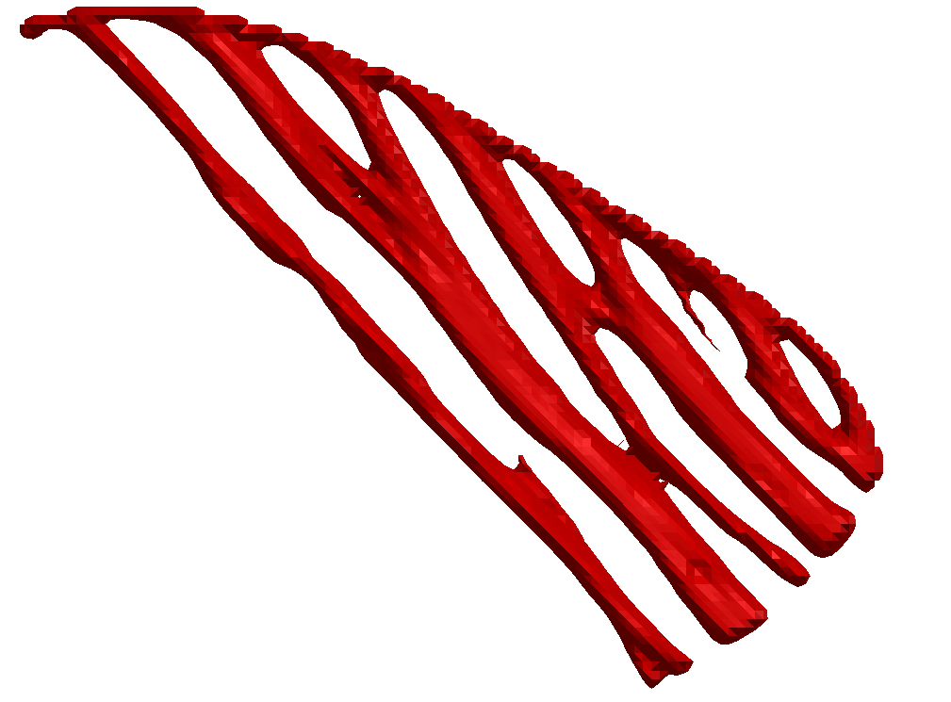
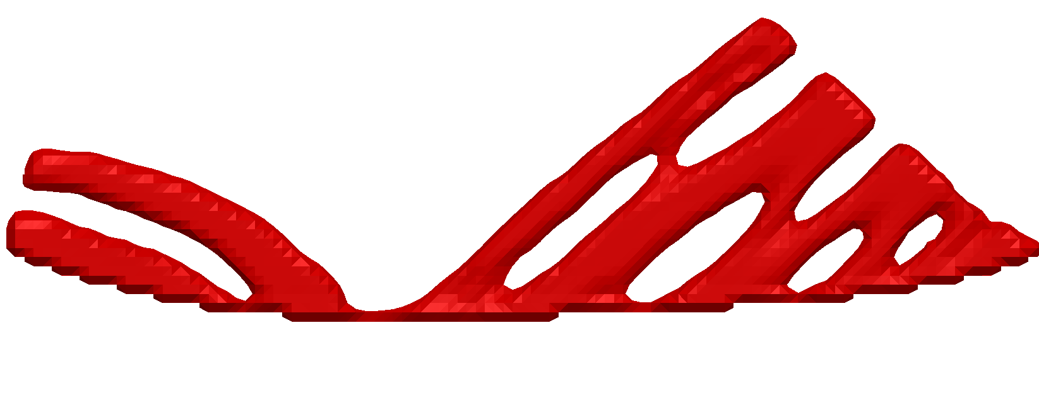
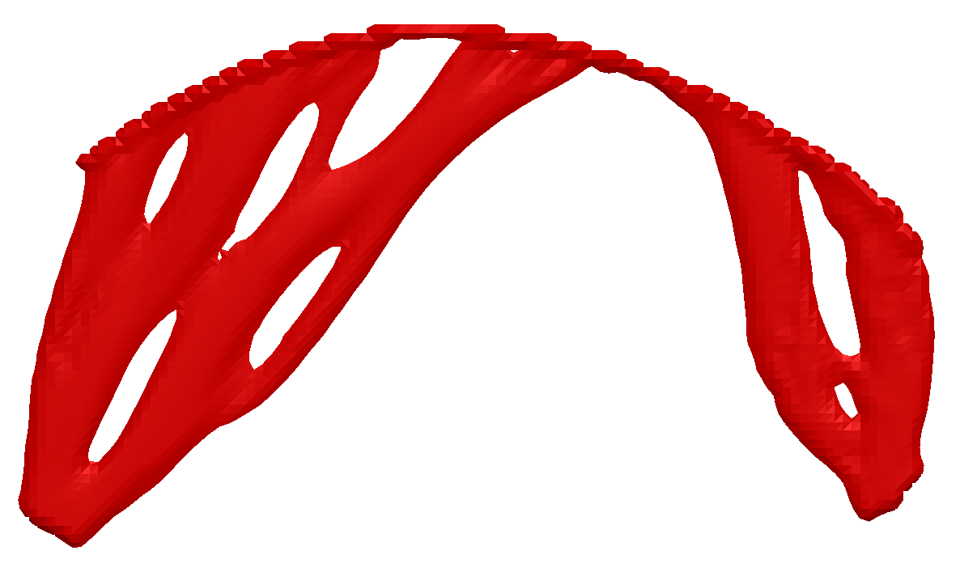
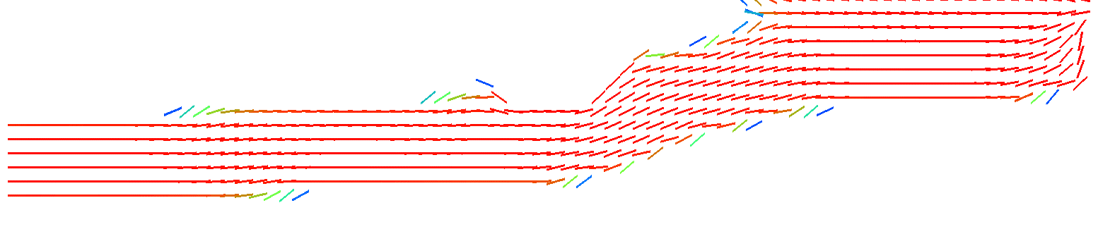
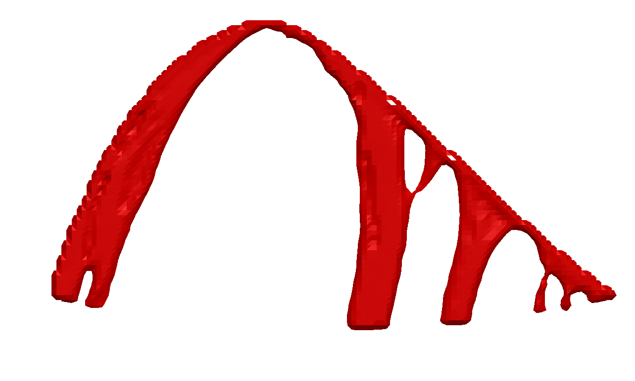
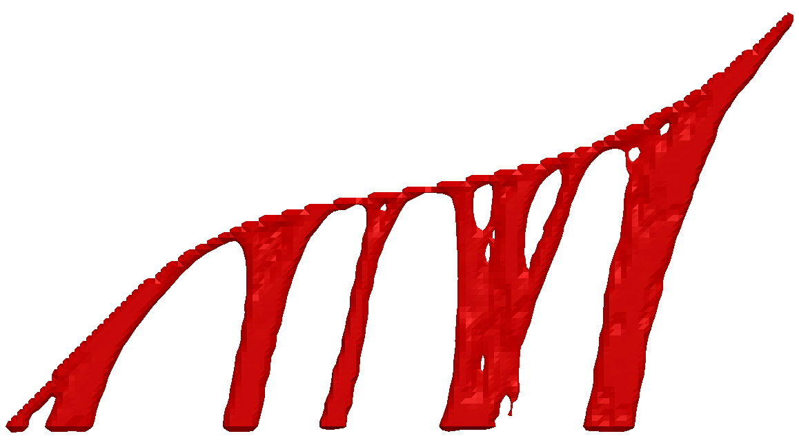
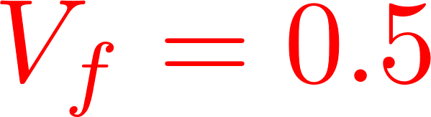

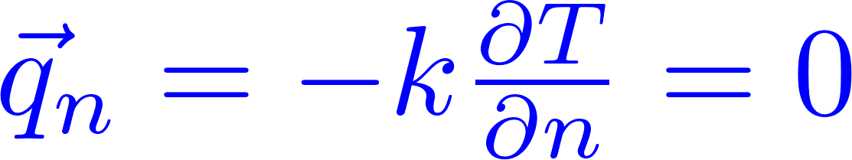




Optimization of Support Structure for Additive Manufacturing Via Pseudo-Fiber Material Model
Aaditya Chandrasekhar, Krishnan Suresh
Design
Q
Support Domain
T
The angle formed by surface normal and build orientation must be less than overhang angle
The thermal conductivity decays about the overhang angle
Support structure material consumption FDM
Support structure material wastage FDM
At regions of void conductivity
Overhanging print
Density turning to zero helps with volume constraint
Design support structures enabling print with minimal volume
Modified material model to achieve overhang control in fibre topology optimization
Improve heat conductivity to build plate for increased dissipation
Unsupported overhangs in metal printing causes burning
Improved heat dissipation : Minimize thermal compliance
Reduce support volume : Volume constraint
Geometric efficient support structure
[Vanek 2014]
Physics : Heat conduction
Q
Overhang length control [Qian 2017]
Bounds on variables
Filter optimization of support and build orientation
[Langelaar 2018]
T
Support TO [Qian 2018]
Functionally optimal structure with implicit definition and control of overhang ?
Autodesk
MeshMixer
Design
Support domain
60%
40%
30%
Q
Design
+
Fiber
Opt.
Support domain
(SIMP)
50%
T
30%
T
Q
Minimal volume support structures
Composite Fiber optimization
Improved heat conduction
Fibres at boundary optimally orient themselves tangential to surface
Representative heat load – Build time heat load ?
Prefixed build orientation – Optimal build orientation?
www.ersl.wisc.edu
achandrasek3@wisc.edu
ksuresh@wisc.edu

